Slide 1

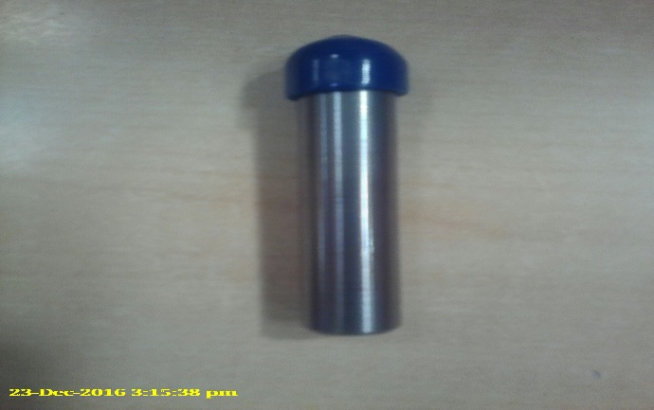
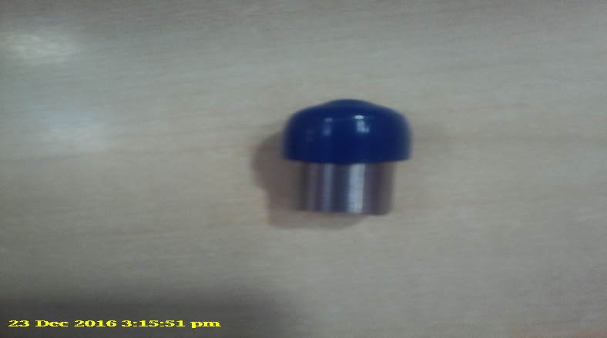
P15
TPM CIRCLE NO :- 01
ACTIVITY
KK
QM
PM
JH
SHE
OT
DM
E&T
KAIZEN IDEA SHEET
TPM CIRCLE NAME: Achiever
LOSS NO. / STEP
DEPT :- MACHINE SHOP
RESULT AREA
P
Q
A
B
C
D
S
M
CELL:- A105 FL WT
CELL NAME: Grinding
MACHINE / STAGE
OPERATION
KAIZEN THEME : To eliminate operator fatigue
IDEA: change dressore size
PROBLEM PRESENT STATUS:: Over size of dressore
COUNTERMEASURE:- Reduce Operator fatigue
BENCHMARK
TARGET
0
KAIZEN START
10/11/2016
TDC
KAIZEN FINISH
01/12/2016
TEAM MEMBERS: Shashikant Kode,
Dabade Parmeswar
Narayan
BENEFITS :-1) Reduce coust
2) save time
KAIZEN SUSTENANCE
WHY - WHY ANALYSIS :-
Why1 :-Operator fatigue
Why2: Over size of dressore
Why3: change dressore size
RESULT :- Reduce operator fatigue
WHAT TO DO:- to reduce operator fautigue
HOW TO DO: Change size
FREQUENCY :-
SCOPE & PLAN FOR HORIZONTAL DEPLOYMENT
Sr No | CELL | TDC | RESP. | STATUS
1 | Grinding
2
ROOT CAUSE : Reduce operator fatigue
REGISTRATION NO. & DATE: 10/11/2016
REGISTERED BY: Shashikant Kode
MANAGER’S SIGN :- d y pawar

